Slide 1
WIREFRAMES

Slide 2
What is a Wireframe?
A wireframe is a visual representation of a user interface, stripped of any visual design or branding elements.
It is used by UX Designers to define the heirarchy of items on a screen and communicate what the items on that page should be based on user needs.
Wireframes comprise lines and outlines of boxes and other shapes to represent emerging interaction designs.

Slide 3
Example
The easiest way to think about a wireframe is in terms of building a house. Before we apply all the paint and furnishings the architect needs to draw the floor plan. He needs to make sure the spaces in the house function well and that they are where the occupants would expect them
The wireframes are the floor plan for your website, creating a vessel for which design and content can flow into.

Slide 4
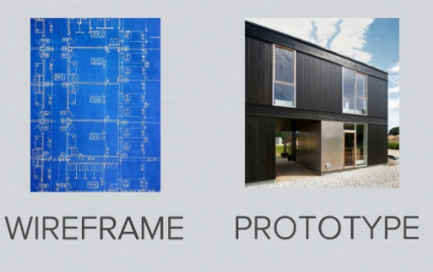
Wireframe is actually a Blueprint!

Slide 5
What they contain?
.Wireframes are embodiments of maps of screen or other state transitions during usage, depicting envisioned task flows in terms of user actions on user interface objects.
The drawing aspects of wireframes are often simple, offering mainly the use of rectangular objects that can be labelled, moved, and resized.

Slide 6
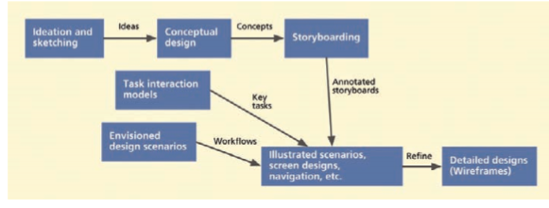
Workflow

Slide 7
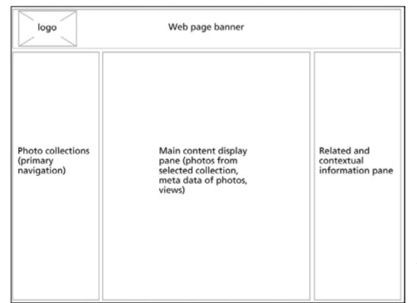
Wireframes are often deliberately unfinished looking; during early stages of design they may not even be to scale. They usually do not contain much visual content, such as finished graphics, colors, or font choices. The idea is to create design representations quickly and inexpensively by just drawing boxes, lines, and other shapes.

Slide 8
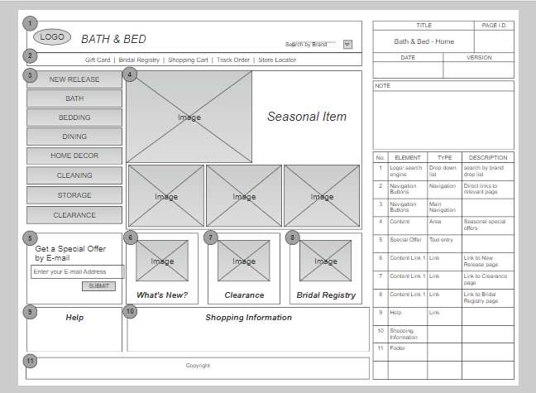
Example: SmartDraw

Slide 9
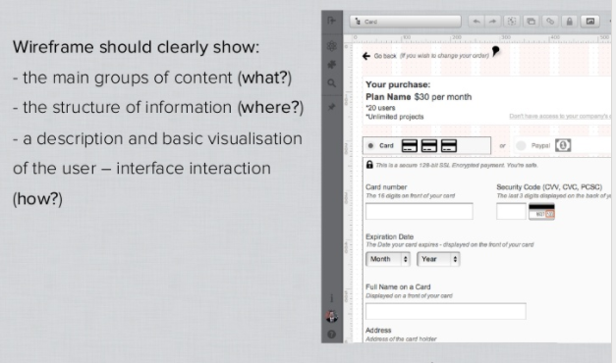
A Wireframe is a low fidelity representation of design

Slide 10
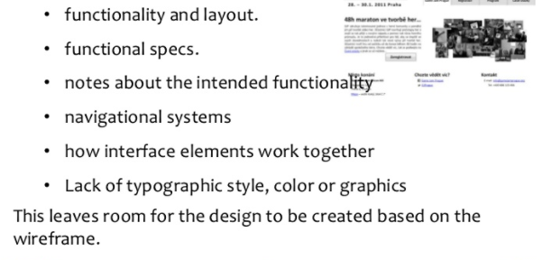
What are Wireframes about?

Slide 11
How are they used?
Wireframes are used as conversational props to discuss designs and design alternatives. They are effective tools to elicit feedback from potential users and other stakeholders.
A designer can move through a deck of wireframes one slide at a time, simulating a potential scenario by pretending to click on interaction widgets on the screen.
These page sequences can represent the flow of user activity within a scenario, but cannot show all possible navigational paths.

Slide 12
How are they built?
Wireframes can be built using any drawing or word processing software package that supports creating and manipulating shapes, such as iWork Pages, Keynote, Microsoft PowerPoint, or Word.
While such applications suffice for simple wire framing, we recommend tools designed specifically for this purpose, such as OmniGraffle (for Mac), Microsoft Visio (for PC), and Adobe InDesign.

Slide 13
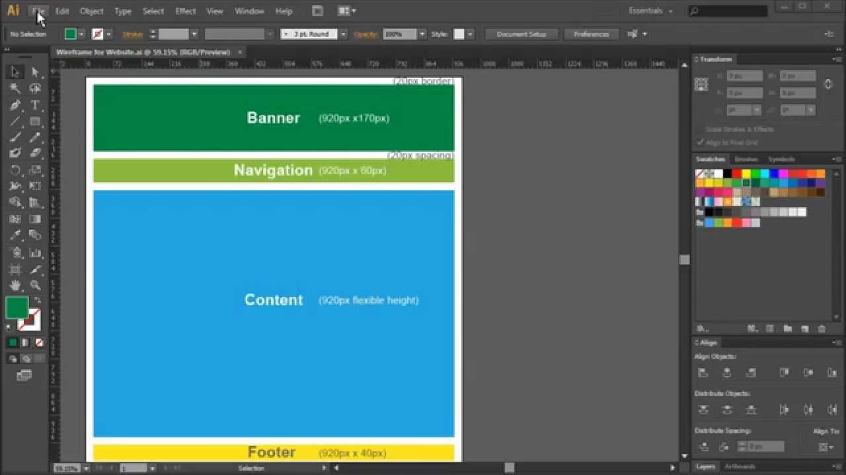
Example: Adobe Wireframe

Slide 14
Sketchy Wireframes
Sometimes, when using wireframes to elicit feedback from users, if you want to convey the impression that the design is still amenable to changes, make wireframes look like sketches.
Straight lines and coloring within the lines give the false impression that the design is almost finished and, therefore, constructive criticism and new ideas are no longer appropriate.
In response, “There is a growing popularity toward something in the middle: Computer-based sketchy wireframes. These allow computer wireframes to look more like quick, hand-drawn sketches while retaining the reusability and polish that we expect from digital artifacts”

Slide 15
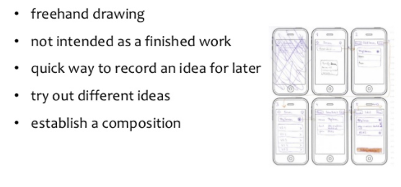
Sketchy Wireframes

Slide 16
THANK YOU

